Slide 1
Lecture 7c: Pipeline Hazards – Data Hazards
To watch lecture video click link below
Lecture 7c video
To view slides, continue to next slide

Slide 2
Lecture 7c: Pipeline Hazards – Data Hazards

Slide 3
Pipeline Issues
Ideal speedup is number of stages in the pipeline. Do we always achieve this?
What makes it easy
all instructions are the same length
just a few instruction formats
memory operands appear only in loads and stores
What makes it hard?
structural hazards: relates to hardware resources
data hazards: an instruction depends on a previous instruction
control hazards: need to worry about branch instructions
We’ll look at these issues

Slide 4
Pipeline Hazards
Hazards
Situations that prevent starting the next instruction in the next cycle
Structural Hazards
Usually deal with hardware resource conflicts
Need to be resolved at datapath design time
Data Hazards
Caused by data dependence
Need to wait for previous instruction to complete its data read/write
Control hazards
Problem with branch or jump instructions where the next instruction’s address is not immediately known
Next PC depends on previous instruction

Slide 5
Resolving Structural Hazards in MIPS Pipeline
Register
Problem: one instruction may reach WB stage while the other may be in ID stage at the same cycle
Solution: write to register using 1st half cycle (triggered by rising edge) while reading using the 2nd half cycle (by falling edge)
Memory – MIPS pipeline with a single memory
Problem: At a cycle, one instruction reaches IF stage that uses memory to fetch instruction while another instruction (lw/sw) reaches MEM stage for data access.
Solution: pipelined datapath requires separate IM and DM, or separate instruction/data caches
ALU
Problem: multiple actions requires ALU: PC+4, beq register subtraction, target address calculation, …
Solution: use additional adders

Slide 6
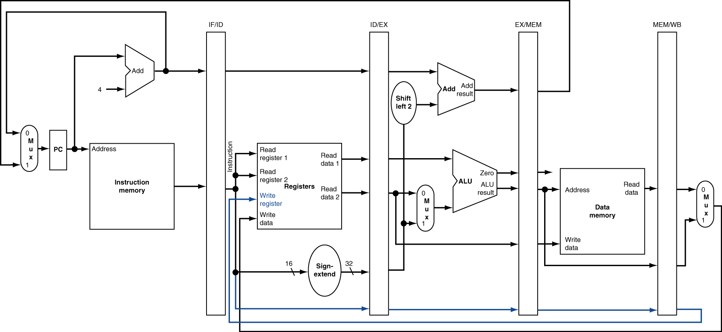
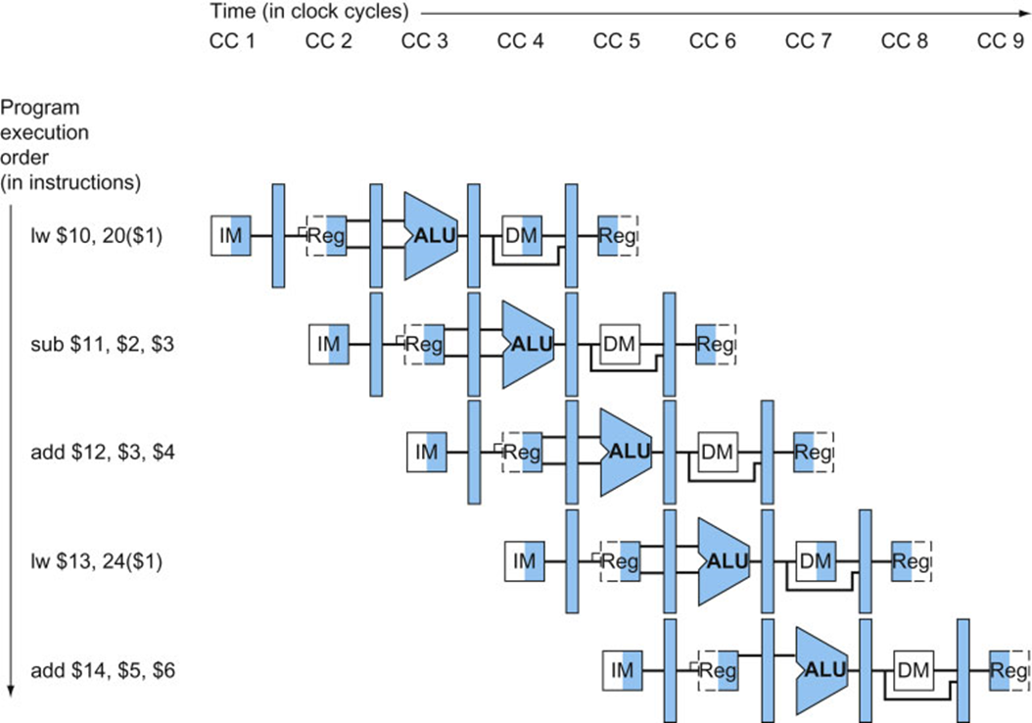
MIPS Pipeline Datapath – free of structural hazard

Slide 7
Data Hazards
Cause: by data dependence
An example of data dependence
add R16, R20, R21
sub R9, R16, R22
Why?
Because starting next instruction before first is finished
dependencies that “go backward in time” are data hazards
Add instruction writes to R16 at CC5 while or instruction reads R16 at CC3
Problem: at CC3 updated R8 value not available yet.
 | CC1 | CC2 | CC3 | CC4 | CC5 | CC6
add | IM | Regs | ALU | DM | Regs
sub |  | IM | Regs | ALU | DM | Regs

Slide 8
Dependencies

Slide 9
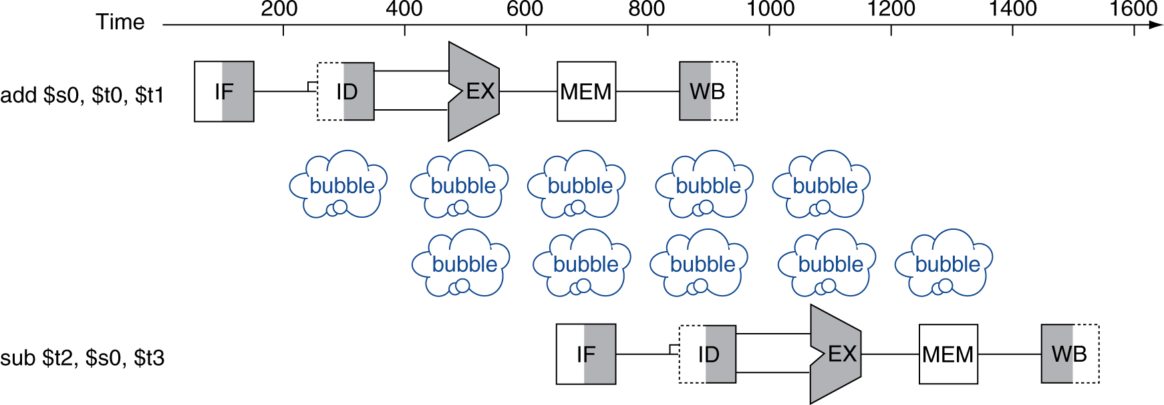
Data Hazards – An easy solution
Solution: waste a few cycles until no more dependence
compiler inserts nop instruction (static solution), or
stalls pipeline (dynamic solution)
add $s0, $t0, $t1 sub $t2, $s0, $t3

Slide 10
Problem with the Easy Solution
Problem: this really slows down!
Best solution for data dependence
forwarding (aka: bypassing)
need hardware support

Slide 11
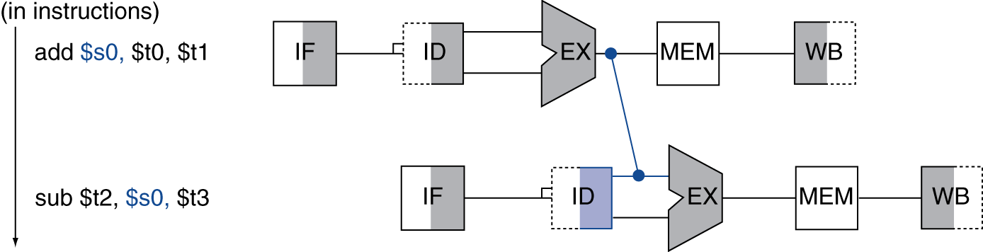
Forwarding
Use result when it is computed
Don’t wait for it to be stored in a register
Requires extra connections in the datapath
add: At the end fo CC3, the new value for $s0 (i.e. R16) is computed but not yet written to R16 yet.
sub: R16 value will not be used till the beginning of CC4.
Forwarding Strategy: forward the ALU output to next cycle’s ALU input directly.

Slide 12
Forwarding to next next instruction
add R16, R20, R21 #data available: ALU output
or R18, R8, R9
sub R9, R16, R22 #data needed: ALU input
Theoretically: forward from add ALU output to sub ALU input
Practically: Pipeline cannot hold data (of CC3) till CC5
(at the beginning of CC5, ALU output data is already of or instr.)
Solution: ALU output pass along with the pipeline (copied via pipeline registers to add’s DM stage, then forward.)
 | CC1 | CC2 | CC3 | CC4 | CC5 | CC6 | CC7 | CC8
add | IM | Regs | ALU | DM | Regs
Or |  | IM | Regs | ALU | DM | Regs
sub |  |  | IM | Regs | ALU | DM | Regs

Slide 13
Forwarding: correct way
add R16, R20, R21 #data available: ALU output
or R18, R8, R9
sub R9, R16, R22 #data needed: ALU input
To forward: the ALU output of add passes to the DM stage along with the instruction execution, and then forward to sub’s ALU input at the beginning of CC5.
 | CC1 | CC2 | CC3 | CC4 | CC5 | CC6 | CC7 | CC8
add | IM | Regs | ALU | DM | Regs
Or |  | IM | Regs | ALU | DM | Regs
sub |  |  | IM | Regs | ALU | DM | Regs

Slide 14
Data Hazards in ALU Instructions
Consider this sequence:
sub $2, $1,$3 Note: $2 and R2 are used interchangeably. and $12,$2,$5 or $13,$6,$2 add $14,$2,$2 sw $15,100($2)
How farther down we need to forward?
Two instructions: next and next next instructions
See the diagram in next slide
Can we always resolve data hazards with forwarding?
For ALU instructions: Yes
But not always, e.g. lw followed by immediate use (will discuss.)

Slide 15
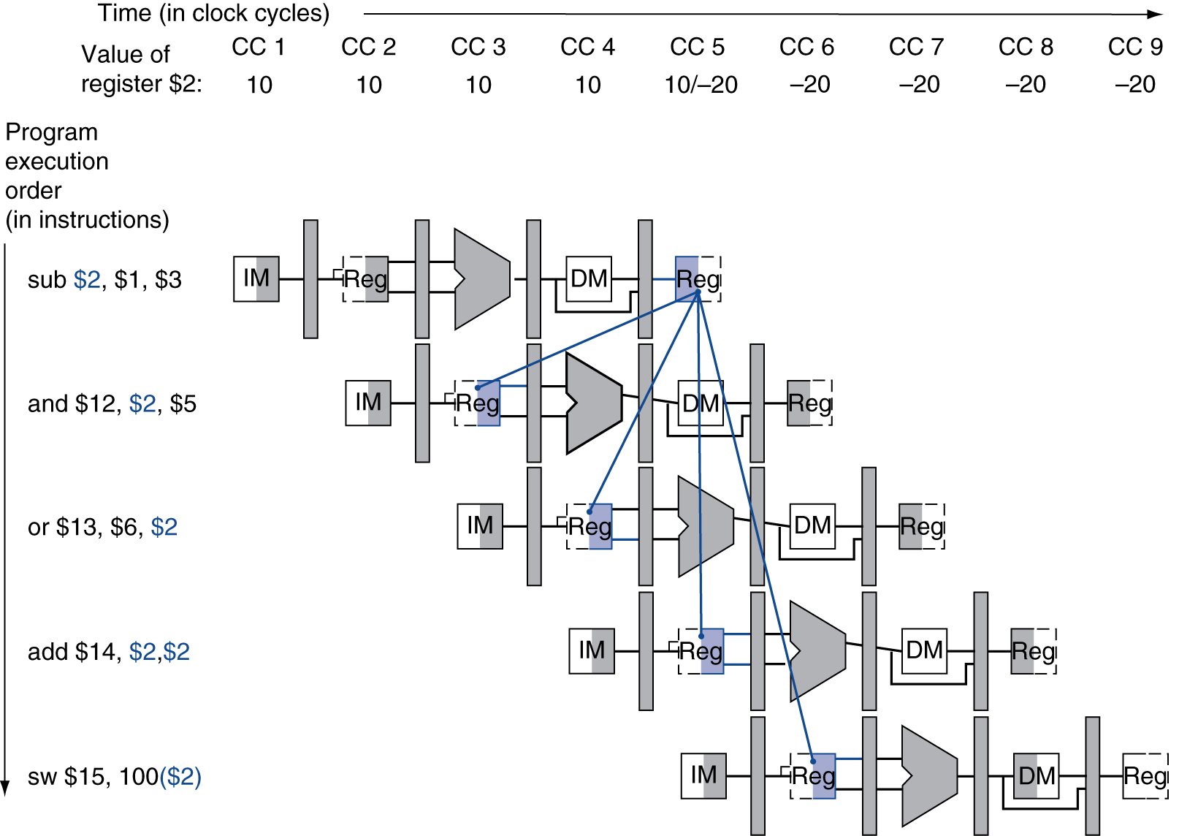
Dependencies & Forwarding
Blue: dependences
Red: forwarding paths.

Slide 16
Note on Forwarding
Can't always forward
Load word can still cause a hazard: lw R16, 0x0000(R12)
add R18, R16, R17
lw: produces value for R16 at end of CC4;
add: need value for R16 at the beginning of CC4
Forwarding: cannot resolve the problem completely.
Thus, we need a hazard detection unit to “stall” the load instruction
 | CC1 | CC2 | CC3 | CC4 | CC5 | CC6
lw | IM | Regs | ALU | DM | Regs
add |  | IM | Regs | ALU | DM | Regs

Slide 17
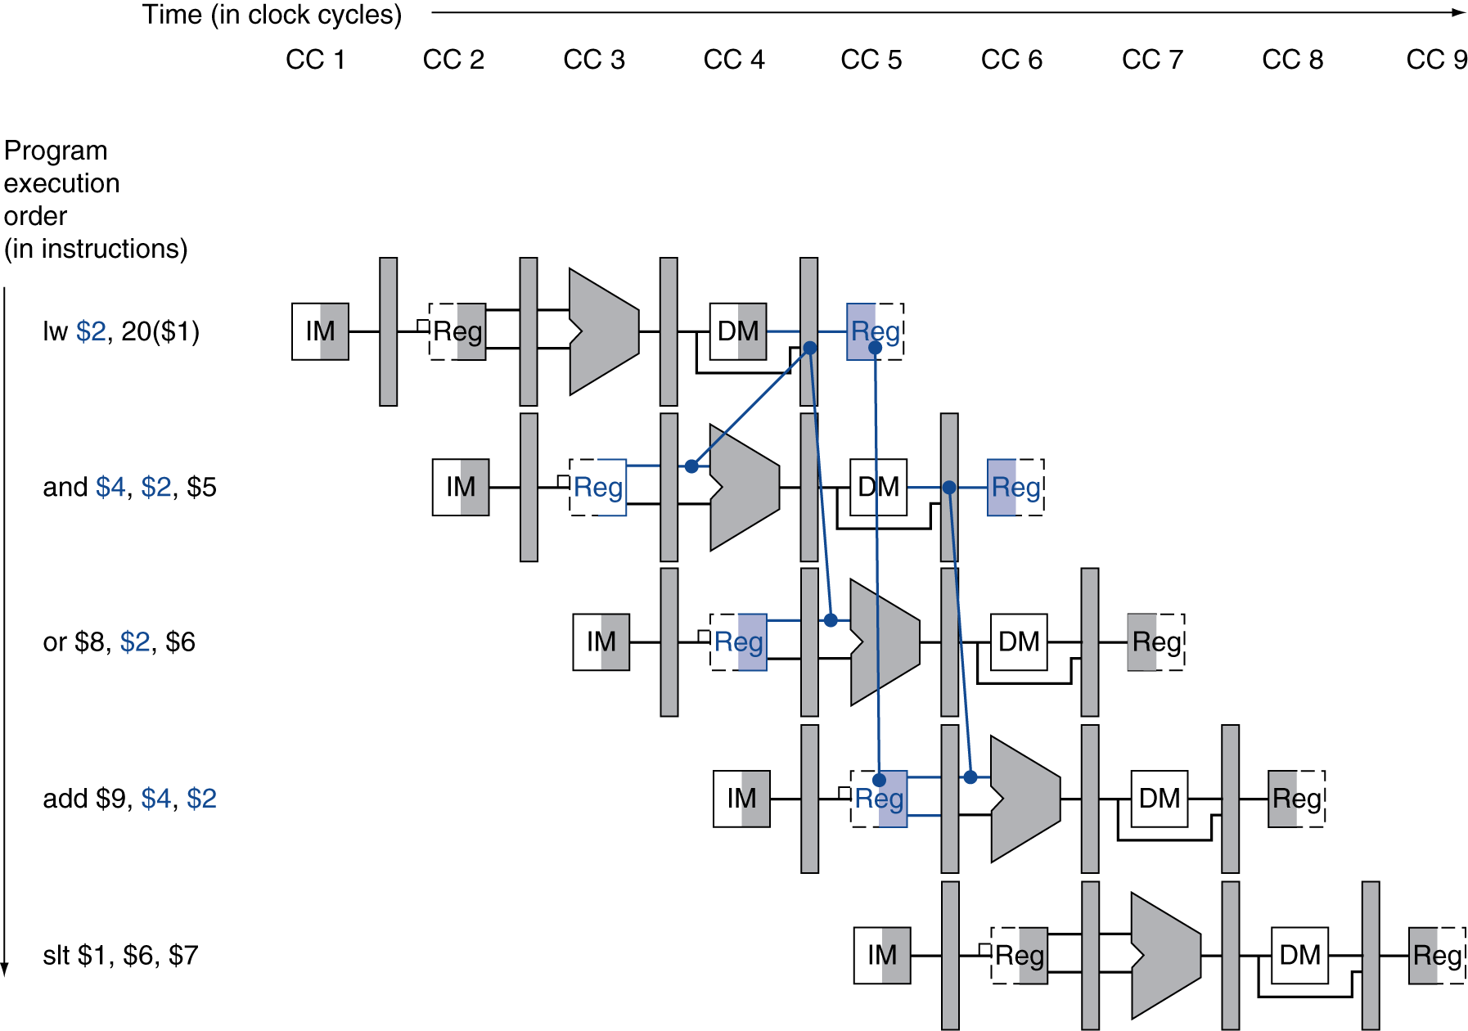
Load-Use Data Hazard: Another Illustration
Need to stall for one cycle

Slide 18
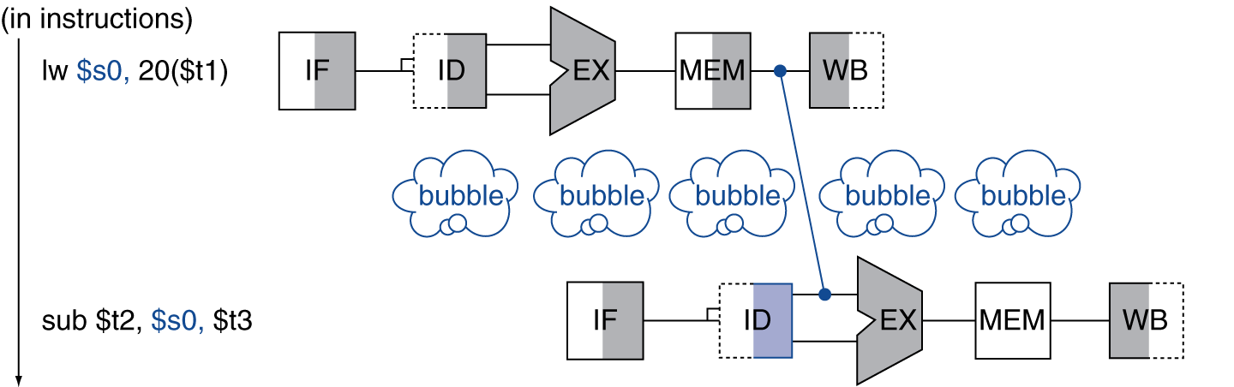
Load-Use Data Hazard: Stall + Forwarding
If forwarding cannot resolve the dependence completely
If value not computed when needed, use “stall”
Can’t forward backward in time!

Slide 19
Avoiding load-use stalls Compiler Code Scheduling
Reorder code to avoid use of load result in the next instruction
C code for A = B + E; C = B + F;
lw $t1, 0($t0)
lw $t2, 4($t0)
add $t3, $t1, $t2
sw $t3, 12($t0)
lw $t4, 8($t0)
add $t5, $t1, $t4
sw $t5, 16($t0)
lw $t1, 0($t0)
lw $t2, 4($t0)
lw $t4, 8($t0)
add $t3, $t1, $t2
sw $t3, 12($t0)
add $t5, $t1, $t4
sw $t5, 16($t0)
stall
stall
13 cycles
11 cycles

Slide 20
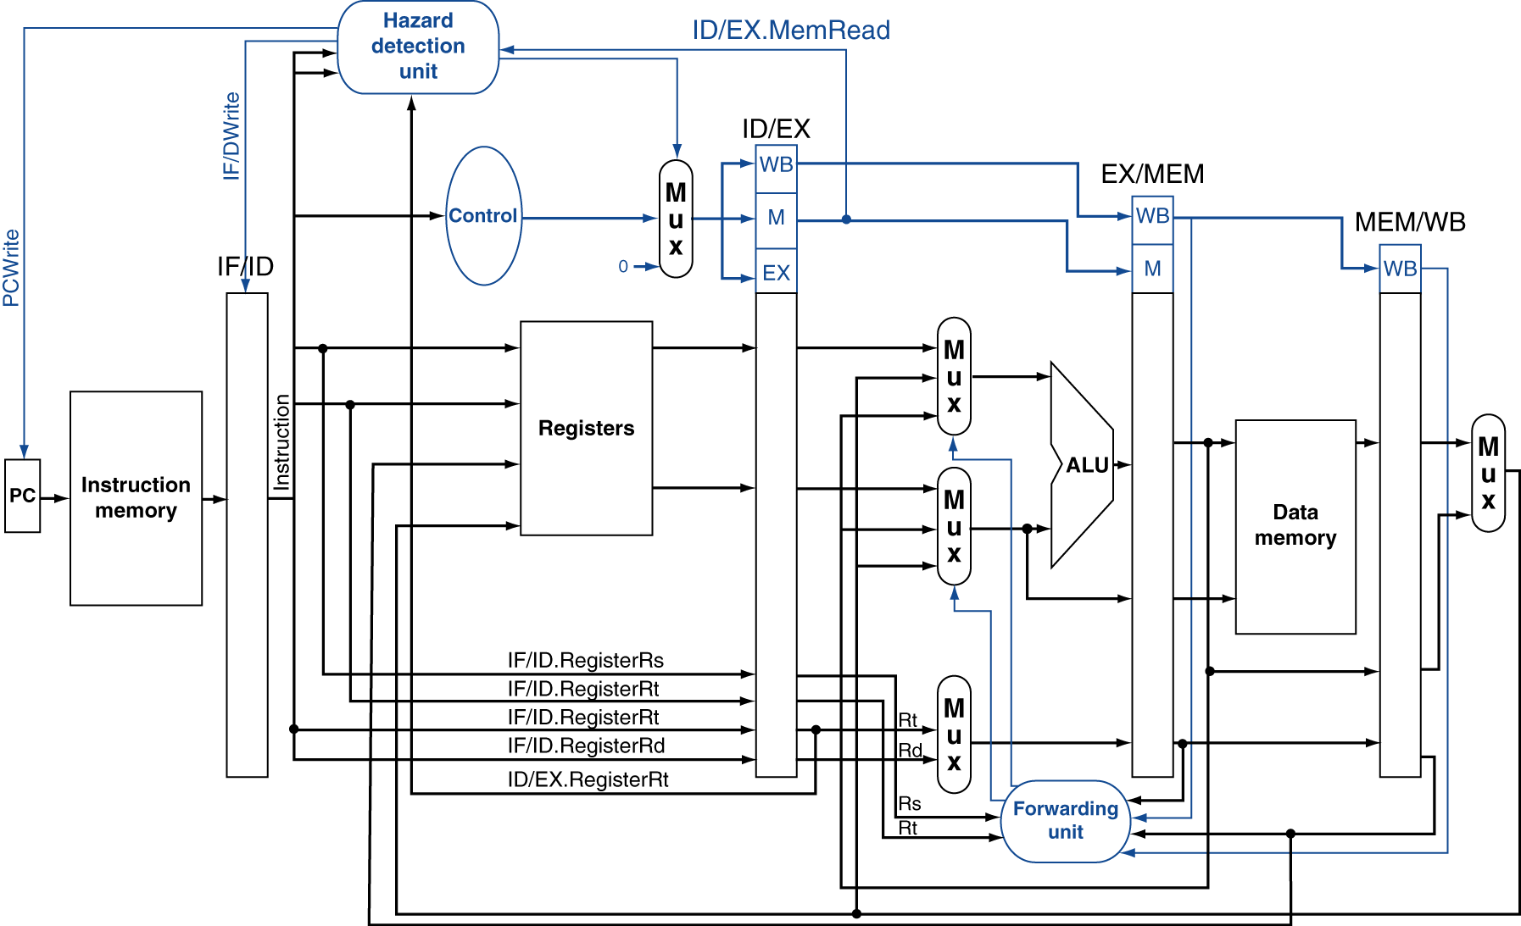
Datapath with Hazard Detection

Slide 21
What we need to know: roles of the hazard detection unit and forwarding unit. Detailed detection and forwarding methods omitted.

Slide 22
More on Data Hazards
Many factors affecting data hazard detection and forwarding
More complicated than we just discussed
We will mention a few cases here with details omitted.
Double Hazards: how to resolve?
add $1,$1,$2 add $1,$1,$3 add $1,$1,$4 #the 2nd forwarding (green) will overwrite the 1st one.
How to stall pipelines?
If a stall needed, control unit will reset the control values of next instruction to do nop (no-operation), i.e. flushes the pipeline and also prevent PC update (so the next instruction will be re-fetched.)
Details omitted.

Slide 23
Practice (1)
Identify data hazards in each of the following sequences, resolve hazard by using forwarding and/or stall (stall only if necessary)
add R16, R20, R21
sw R20, 0x0040 (R16)
(b) add R16, R20, R21
sw R16, 0x0040 (R20)

Slide 24
Practice (2)
Identify data hazards in each of the following sequences, resolve hazard by using forwarding and/or stall (stall only if necessary)
lw R16, 0x0020(R22)
sw R20, 0x0040(R16)
(b) lw R16, 0x0020(R22)
sw R16, 0x0040(R20)

Slide 25
Summary
Pipelining subject to hazards
Structure, data, control
Structural hazards: must be resolved before the pipeline put into operation
Data hazards
Hazard detection
Forwarding and sometimes also need a stall
Control hazards (next lecture)

